Slide 1
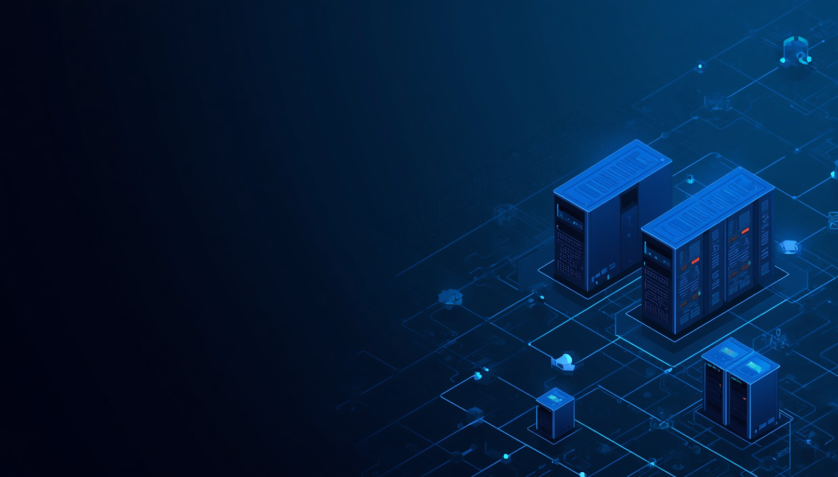
Containerization
& Orchestration in Service-Oriented Computing

Slide 2

Learning Outcomes
Explain container technology and its core concepts
Differentiate between virtual machines and containers
Describe Docker architecture, images, containers, and registries
Understand Kubernetes architecture and container orchestration
Explain orchestration's role in scalable cloud services

Slide 3
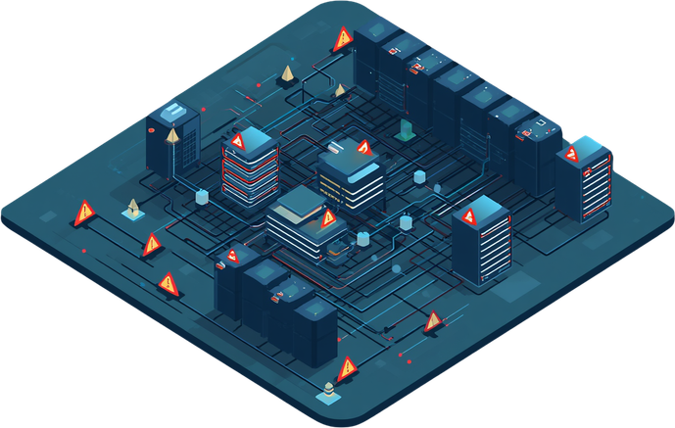
Service-Oriented Deployment Challenges
Dependency Conflicts
Environment Inconsistency
Scaling & Maintenance Cost
Multiple independent services require different library versions, causing conflicts and breaking builds when deployed on shared environments.
Applications behave differently across development, testing, and production environments, making it difficult to reproduce and resolve bugs.
Scaling individual services is complex and costly. High maintenance overhead arises from managing multiple runtimes, configurations, and deployment pipelines.

Slide 4
Evolution of Application Deployment
01
Traditional Applications
03
Containers
Apps deployed directly on physical servers with fixed dependencies. Environment inconsistencies and high maintenance costs were common challenges.
Lightweight, portable units packaging app code with all dependencies. Consistent across environments, fast to start, and efficient in resource usage.
02
Virtual Machines
04
Container Orchestration & Cloud Native
Hypervisors enabled multiple OS instances on one host. Improved isolation and resource use, but VMs remained heavyweight with slow startup times.
Platforms like Kubernetes automate deployment, scaling, load balancing, and self-healing across clusters, enabling cloud-native application architectures.

Slide 5
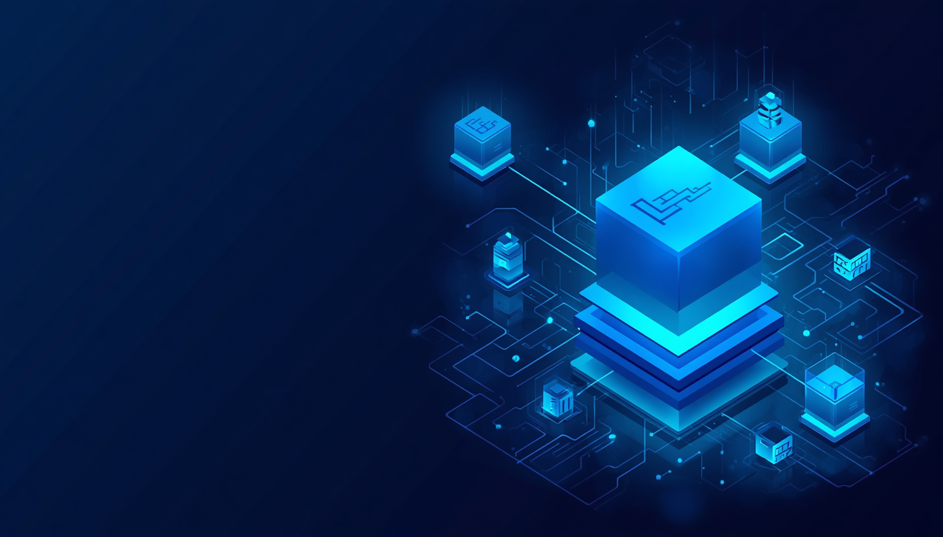
What is a Container?
A lightweight, portable software package that includes everything needed to run an application — code, runtime, libraries, and dependencies.
• Portable — runs consistently across any environment
• Lightweight — shares the host OS kernel, minimal overhead
• Fast — starts in milliseconds, rapid deployment
• Isolated — processes run independently from each other
• Consistent — same behavior in dev, test, and production
• Secure — encapsulated environment limits exposure
Containers package all dependencies into a single unit, eliminating "it works on my machine" problems and enabling seamless deployment across cloud environments.

Slide 6
Container Architecture
01
Application & Libraries
03
Docker Container & Engine
The topmost layer contains the application code and all required libraries. This layer is unique to each container and defines the software running inside the isolated environment.
The Docker Container wraps all upper layers into a portable unit. The Docker Engine manages container lifecycle operations including creation, execution, networking, and resource allocation.
02
Dependencies & Runtime
04
Host Operating System
Below the application sit the dependencies and runtime environment. These provide the necessary execution context, ensuring consistent behavior regardless of the underlying host system.
The Host OS provides the kernel and core system resources shared across all containers. Docker leverages the host kernel directly, making containers significantly lighter than virtual machines.

Slide 7

Virtual Machine vs Container
Virtual Machine (VM)
Container
OS: Full OS per VM (Guest OS)
Hypervisor: Required (VMware, Hyper-V)
Startup Time: Minutes (slow boot)
Resource Usage: High (GB of RAM/storage)
Performance: Moderate overhead
Isolation: Strong (hardware-level)
Storage: Large image size (GBs)
Portability: Limited, OS-dependent
Scalability: Slower, heavier scaling
OS: Shares Host OS kernel
Hypervisor: Not required
Startup Time: Seconds (near-instant)
Resource Usage: Low (MBs of RAM/storage)
Performance: Near-native, minimal overhead
Isolation: Process-level (namespace)
Storage: Small image size (MBs)
Portability: Highly portable across environments
Scalability: Fast, lightweight scaling
Key Takeaway
Containers are lightweight, fast, and portable alternatives to VMs. While VMs offer stronger isolation with a full OS per instance, containers share the host OS kernel — enabling faster startup, lower resource consumption, and greater scalability, making them ideal for modern cloud-native and microservices architectures.

Slide 8
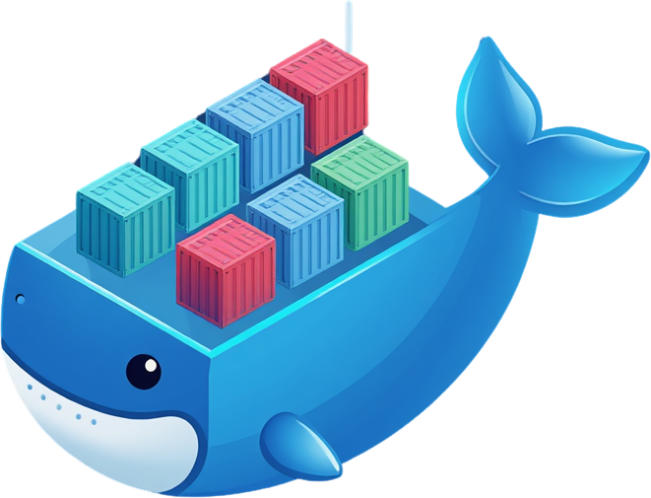
Introduction to Docker
History & Key Features
Impact on Developer Productivity
Docker was launched in 2013 by Solomon Hykes at dotCloud. It revolutionized software deployment by packaging applications with all dependencies into portable containers. Key features include: lightweight containerization, image-based deployment, Docker Hub registry, cross-platform portability, and rapid application startup times.
Docker eliminates the "works on my machine" problem by ensuring consistent environments across development, testing, and production. Developers can build, ship, and run applications faster, streamline CI/CD pipelines, reduce infrastructure costs, and collaborate efficiently using shared container images from registries.

Slide 9
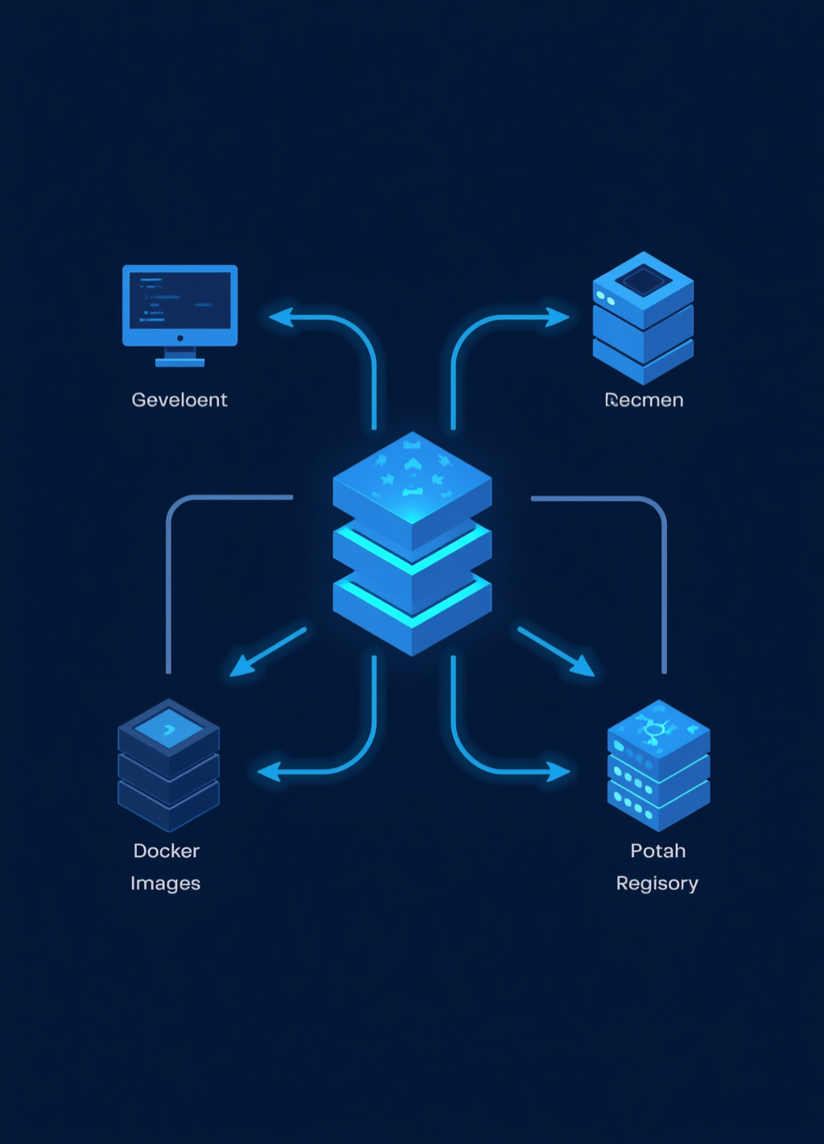
Docker Architecture
01
Developer & Docker Client
03
Docker Images & Containers
The Developer writes Dockerfiles and issues commands via the Docker Client (CLI or API). The client communicates with the Docker Daemon by sending build, pull, and run instructions.
Docker Images are read-only layered templates used to create containers. Docker Containers are running instances of images — isolated, lightweight processes sharing the host OS kernel.
02
Docker Daemon & Engine
04
Docker Registry
The Docker Daemon (dockerd) listens for API requests and manages Docker objects. The Docker Engine combines the daemon, REST API, and CLI to build and run containers on the host OS.
The Docker Registry stores and distributes Docker images. Docker Hub is the default public registry. Teams can also use private registries such as Azure ACR, Amazon ECR, or Google Artifact Registry.

Slide 10
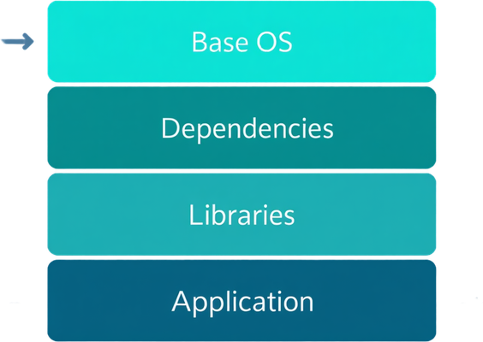
Docker Images
Definition & Characteristics
Layered Read-Only Structure
Creation & Repository Storage
A Docker image is a lightweight, standalone, read-only template used to create containers. It packages application code, libraries, dependencies, and runtime into a single portable unit.
Images are built in immutable layers stacked on a base image. Each layer represents a change or instruction. Layers are cached and reused, making builds faster and storage efficient.
Images are created using a Dockerfile with build instructions. Once built, images are tagged and pushed to registries such as Docker Hub or private repositories for sharing and deployment.

Slide 11
Docker Containers
01
Start
03
Restart
A container is launched from a Docker image using the docker run command. The container process begins executing in an isolated environment with its own filesystem, network, and resources.
A stopped container can be restarted using docker restart, resuming execution from its last state. This is useful for applying configuration changes or recovering from unexpected failures.
02
Stop
04
Delete
A running container can be stopped gracefully using docker stop, which sends a termination signal and allows the process to shut down cleanly before the container enters a stopped state.
A stopped container can be permanently removed using docker rm, freeing up system resources. Once deleted, the container instance is gone, though its source image remains available for new instances.

Slide 12
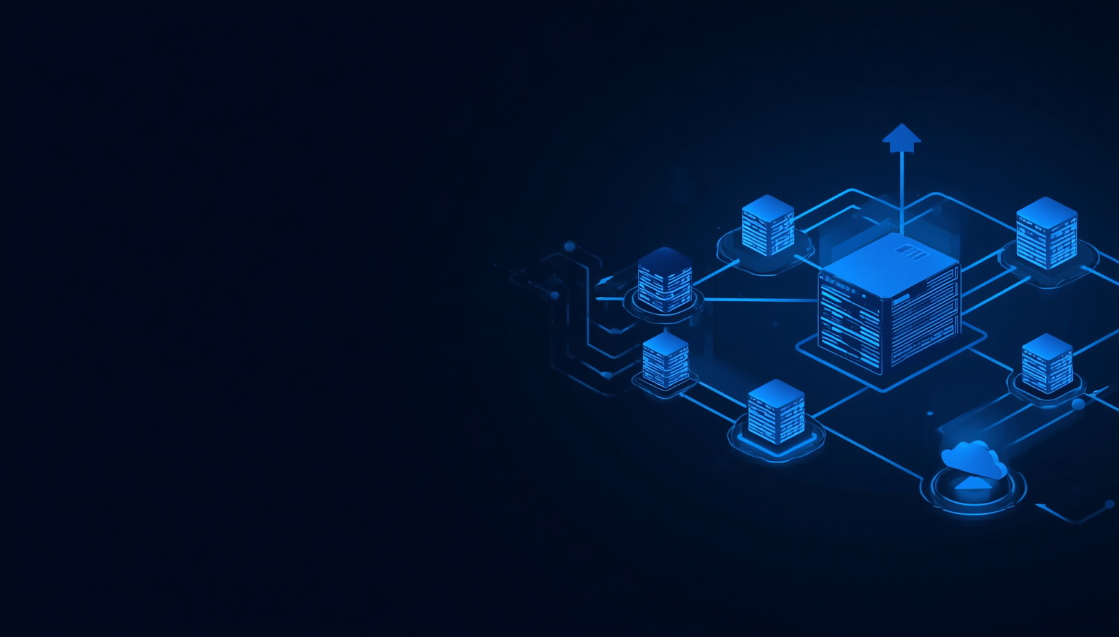
Docker Registries
Docker Hub
Azure Container Registry
Amazon Elastic Container Registry
Google Artifact Registry
Private Registries
Registries store and distribute Docker images. Developers push images to a registry and pull them to any container host for deployment.

Slide 13

Docker Workflow
Write Dockerfile — define app environment and dependencies
Docker Build — create a Docker image from the Dockerfile
Docker Push — upload the image to a Docker registry
Docker Pull — download the image from the registry
Docker Run — instantiate a running container from the image
Each step in the Docker workflow transforms source code into a portable, running container — enabling consistent deployment across any environment.

Slide 14

Important Docker Commands
docker build
docker images
docker run
docker ps
docker stop
docker rm
docker pull
docker push
docker exec
docker logs
Key Docker CLI commands for building images, managing containers, interacting with registries, and monitoring running processes.

Slide 15
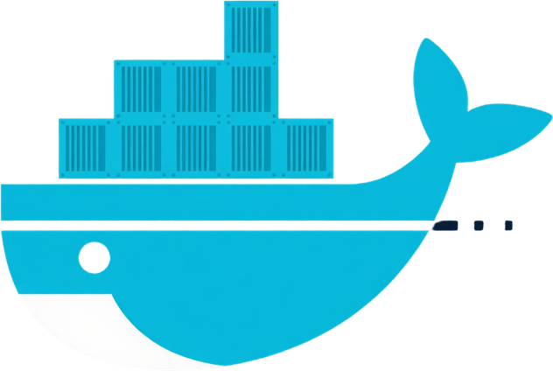
Benefits of
Docker
Fast Deployment & Portability
Scalability & Process Isolation
Efficient Resources & Continuous Delivery
Docker containers launch in seconds, enabling rapid deployment cycles. Containers run consistently across development, testing, and production environments, eliminating environment-specific issues.
Applications scale horizontally with ease by spinning up additional containers. Each container runs in isolation, preventing dependency conflicts and improving overall system stability and security.
Docker shares the host OS kernel, using far fewer resources than virtual machines. Seamlessly integrates with CI/CD pipelines, enabling consistent and automated software delivery workflows.

Slide 16
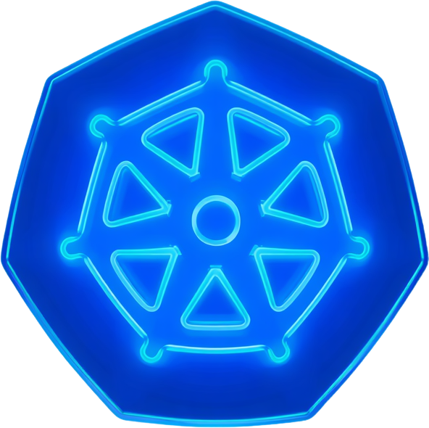
Introduction to Kubernetes
What is Kubernetes & Key Features
Advantages & Docker Integration
Kubernetes (K8s) is an open-source container orchestration platform that automates deployment, scaling, and management of containerized applications. Key features include: automatic scheduling, self-healing, horizontal scaling, service discovery, load balancing, and rolling updates with zero downtime.
Advantages over manual management: eliminates human error, ensures high availability, and automates repetitive tasks. Kubernetes works seamlessly with Docker — Docker packages and runs containers, while Kubernetes orchestrates and manages them at scale across clusters of machines.

Slide 17
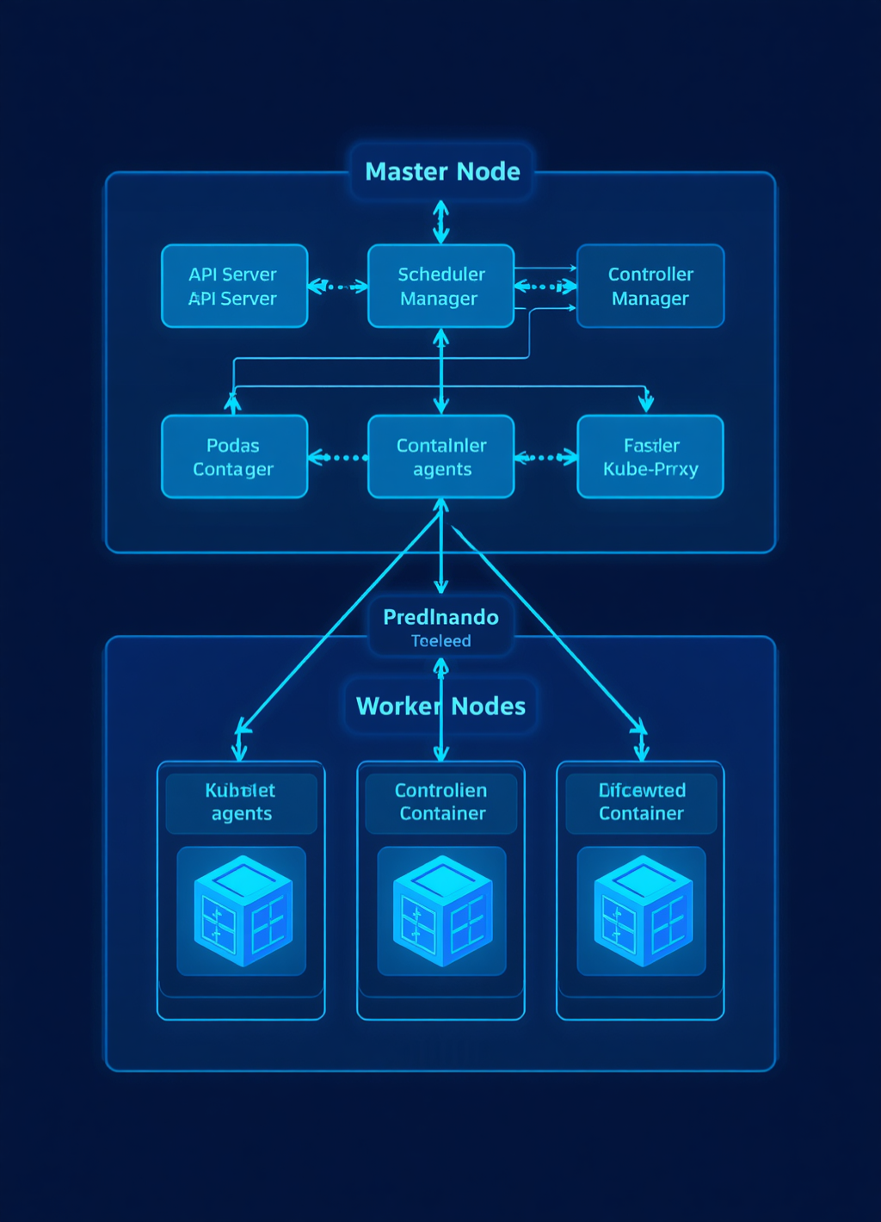
Kubernetes Architecture
01
API Server
03
Worker Nodes
The central management component of the Master Node. Exposes the Kubernetes API, handles all REST requests, and serves as the front-end for the control plane.
Host the actual workloads. Each node runs a Kubelet agent, a container runtime (Docker), and Kube-Proxy to manage networking and Pod execution.
02
Scheduler
17
Controller Manager
Assigns newly created Pods to available Worker Nodes based on resource availability, affinity rules, and scheduling policies defined in the cluster.
Monitors cluster state via the API Server and reconciles actual state with desired state. Manages node, replication, endpoints, and service account controllers.

Slide 18
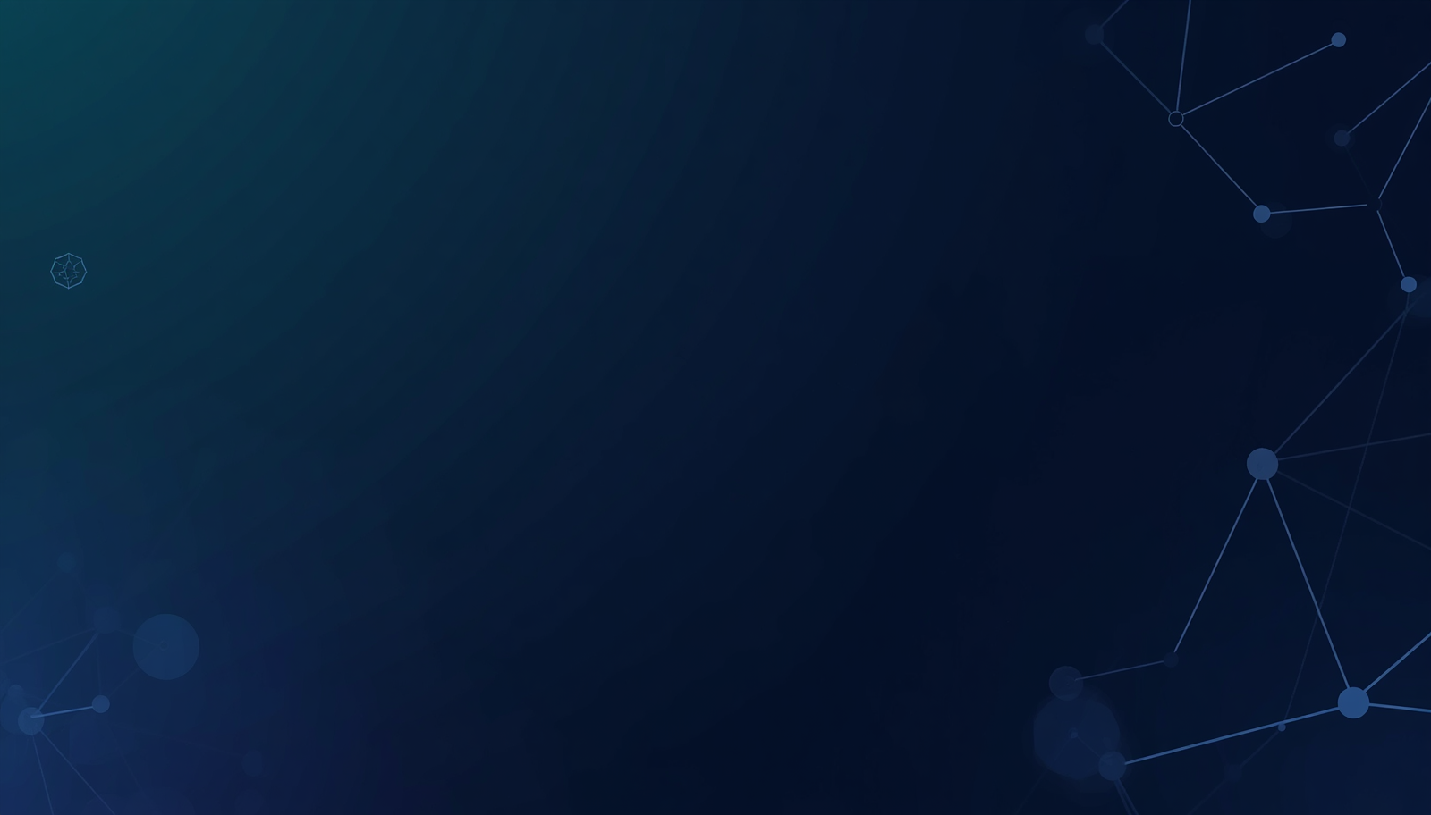
Kubernetes Components
Pods & Nodes
ConfigMaps & Secrets
Pod: Smallest deployable unit in Kubernetes; holds one or more containers sharing network and storage.
Node: A worker machine (virtual or physical) that runs pods under the control of the Master Node.
Deployment: Manages desired state for pods; handles rolling updates and rollbacks automatically.
ConfigMap: Stores non-sensitive configuration data as key-value pairs; decouples config from container images.
Secret: Securely stores sensitive data such as passwords, tokens, and API keys in encoded form.
Scheduler: Assigns pods to nodes based on resource availability, constraints, and affinity rules.
ReplicaSets & Services
ReplicaSet: Ensures a specified number of pod replicas are running at all times for high availability.
Service: Stable network endpoint that exposes pods; enables load balancing and service discovery.
Namespace: Virtual cluster within Kubernetes; isolates resources and organizes workloads by team or environment.

Slide 19

Container Orchestration Features
Automatic Deployment & Auto-Scaling
Scheduling & Load Balancing
Health Monitoring & Self-Healing
Rolling Updates & Rollback
High Availability Management
Orchestration platforms like Kubernetes automate the full lifecycle of containerized services — ensuring reliability, scalability, and zero-downtime operations across distributed cloud environments.

Slide 20
Why Orchestration is Important
Manual Container Management
Kubernetes-Managed Environment
Manual deployment of each container instance
No automatic scaling — operator must intervene
Downtime during updates and failures
Error-prone, repetitive configuration tasks
Automatic scaling based on demand and load
Built-in load balancing across all pods
Self-healing: auto-restarts failed containers
High availability with zero-downtime rolling updates
Scaling & Deployment
Automation & Reliability
High maintenance cost and human effort
Inconsistent environments across servers
Difficult to manage hundreds of containers
Limited fault tolerance and recovery options
Declarative configuration with desired state management
Namespace isolation and resource optimization
Centralized monitoring, logging, and health checks
Seamless rollback to previous stable versions

Slide 21

Real-World Applications of Container Orchestration
Netflix — Microservices at massive scale with Kubernetes
Spotify — Container-based deployment for global streaming
Uber — Orchestrated services for real-time ride matching
Amazon — EKS-powered scalable cloud infrastructure
Google — Kubernetes origin; runs billions of containers
Microsoft — Azure AKS for enterprise container management
Leading global companies rely on container orchestration to achieve high availability, rapid scaling, and consistent deployment across distributed cloud environments.

Slide 22

Advantages & Challenges of Container Orchestration
Advantages
Key Takeaway
✔ High Availability — Services remain online with automatic failover and redundancy across nodes.
✔ Portability — Containers run consistently across dev, test, and production environments.
✔ Automation — Deployment, scaling, and recovery are fully automated by the orchestrator.
✔ Scalability — Workloads scale up or down instantly based on demand.
✔ Resource Optimization — Efficient bin-packing maximizes CPU and memory utilization.
Container orchestration with Kubernetes delivers powerful automation, resilience, and scalability for cloud-native applications. While the initial complexity and learning curve are notable challenges, the long-term operational benefits — including zero-downtime deployments, self-healing infrastructure, and elastic scaling — make orchestration essential for modern service-oriented architectures at scale.
Challenges
✘ Complexity — Setup and ongoing management of clusters requires significant expertise.
✘ Networking — Service discovery, DNS, and inter-pod communication add intricacy.
✘ Security — Container isolation, RBAC, and secrets management demand careful configuration.
✘ Monitoring — Observability across many containers and nodes is difficult without proper tooling.
✘ Learning Curve — Teams must invest time to master Kubernetes concepts and best practices.

Slide 23
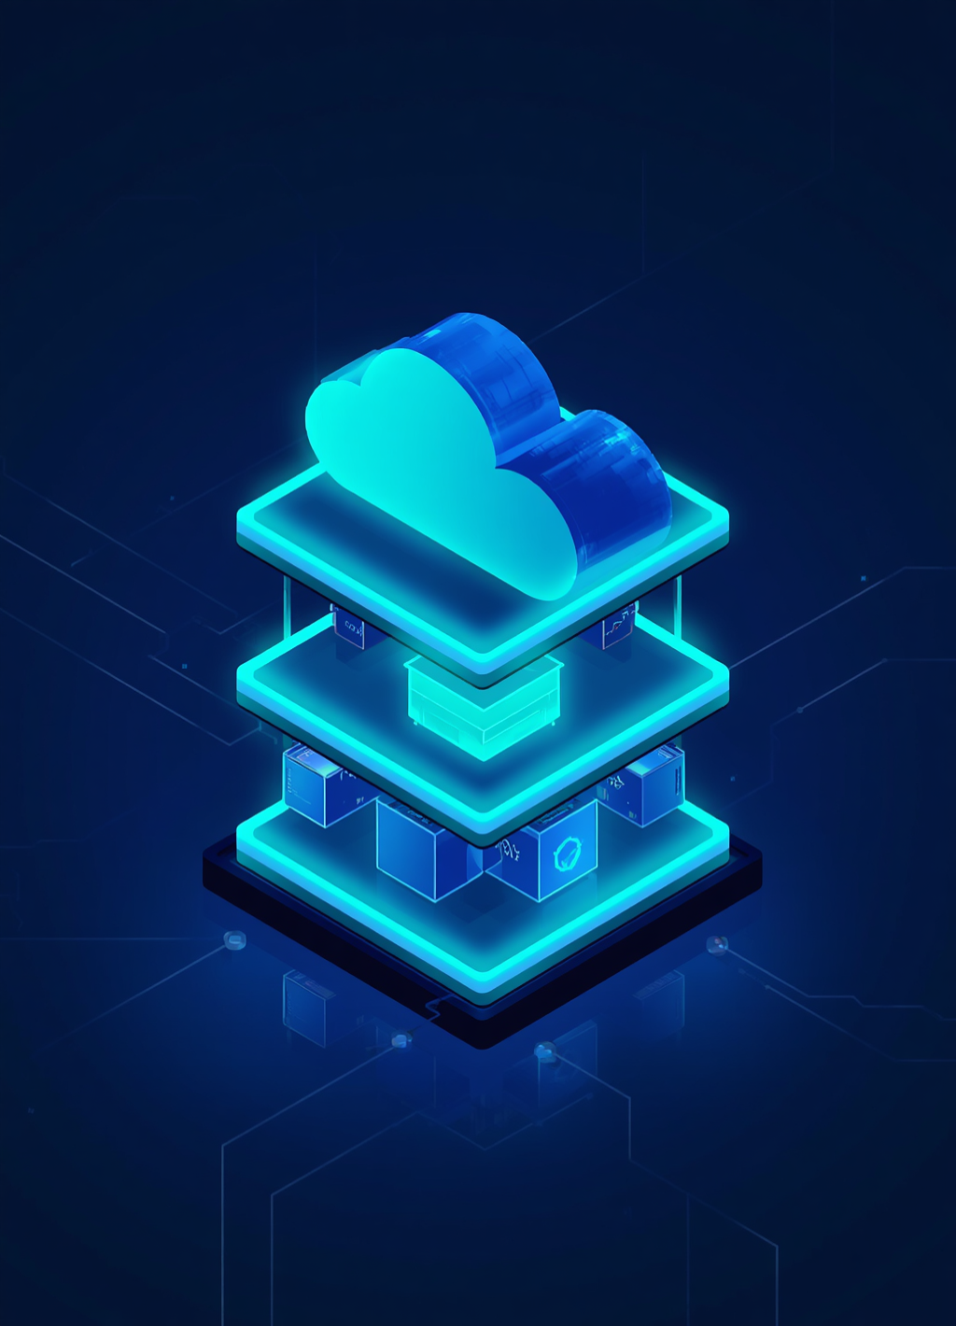
Case Study: Microservices-Based Online Shopping System
01
Users & API Gateway
03
Docker & Kubernetes
End users send requests to a central API Gateway, which routes traffic to the appropriate backend microservice. The gateway handles authentication, load balancing, and request management.
Each microservice runs in its own Docker container. Kubernetes orchestrates all containers, managing deployment, auto-scaling, health checks, and rolling updates across the cluster.
02
Microservices Layer
04
Cloud Infrastructure
Four independent services handle core business logic: Product Service, Order Service, Payment Service, and Inventory Service — each deployed and scaled independently.
The entire Kubernetes cluster is hosted on cloud infrastructure, providing high availability, elastic scaling, persistent storage, and global accessibility for the shopping platform.

Slide 24
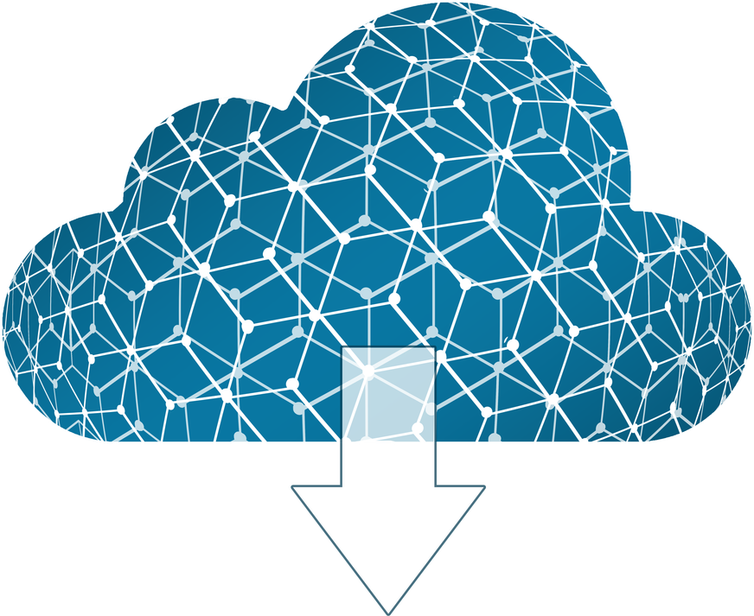
Summary of Key Concepts
Container Technology & Docker
Images, Containers & Registries
Kubernetes & Orchestration
Containers are lightweight, portable, isolated software packages bundling app code and dependencies. Docker provides a platform to build, ship, and run containers consistently across environments with high efficiency.
Docker images are read-only layered templates; containers are their running instances. Registries such as Docker Hub, Azure CR, and Amazon ECR store and distribute images via push/pull workflows.
Kubernetes automates deployment, scaling, load balancing, and self-healing of containerized services. Its master-worker architecture manages pods across nodes, enabling high availability and zero-downtime rolling updates.

Slide 25

Quiz: Test Your Knowledge
Q1. What is the main advantage of containers over virtual machines?
A) Containers include a full OS B) Containers are lightweight and share the host OS kernel C) Containers require a hypervisor D) Containers are slower to start
Q2. Which component of Docker is responsible for building and running containers?
A) Docker Registry B) Docker Client C) Docker Daemon D) Docker Hub
Q3. What is a Docker image?
A) A running container instance B) A read-only template used to create containers C) A storage registry D) A network configuration file
Q4. In Kubernetes architecture, which component schedules workloads onto worker nodes?
A) Controller Manager B) kubelet C) API Server D) Scheduler
Q5. Which feature of container orchestration ensures a failed container is automatically restarted?
A) Load balancing B) Rolling updates C) Self-healing D) Auto-scaling
Answers: Q1-B | Q2-C | Q3-B | Q4-D | Q5-C

